Slide 1
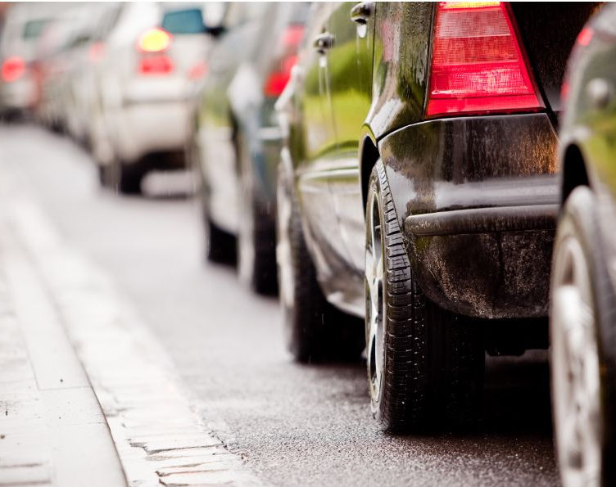

Traffic Volume in Minnesota Interstate

Slide 2


Goal of the project
Make important infrastructure decisions.
These decisions will ensure that any construction in the future won’t cause problems for drivers.

Slide 3
Metric Selection
Date time
Traffic volume Patterns throughout month, day, and hour.
Weather
Impact of weather conditions on Traffic volume.
Holidays
Traffic volume on different holidays and special events.

Slide 4
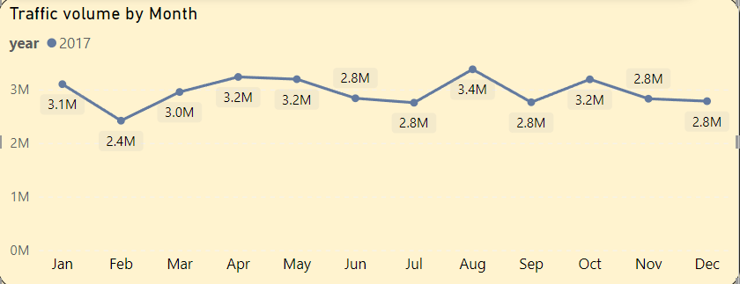
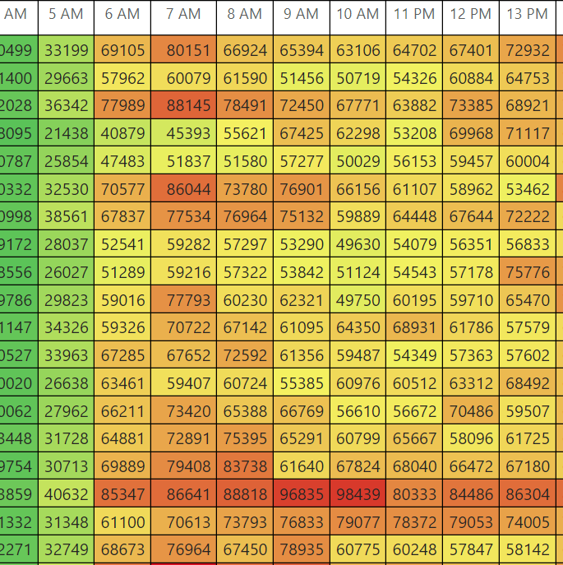
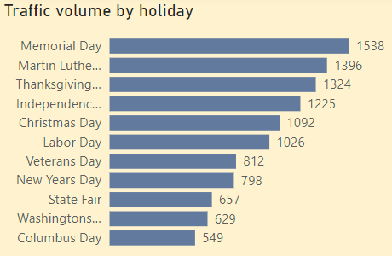
Visualization Techniques:
Line charts to illustrate trends in traffic volume over time.
Heatmaps to visualize traffic patterns throughout the day and hour.
Bar charts to compare traffic volume across different weather conditions and holidays.

Slide 5
Monthly Trend in 2017
February - Lowest Month,
best possible month for construction changes
August - Highest volume, possible end of summer seasonal traffic

Slide 6
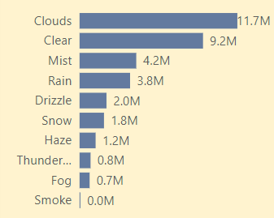
Impact of Weather Conditions (2017)
Clear/cloudy conditions result in the highest traffic volume.
Precipitation has a significant impact on traffic volume, though a surprising number of motorists continue to drive in rain

Slide 7
Busiest Holiday (2017)
August - State fair starting in August .
January - High traffic on New Years and Martin Luther King Jr. Day contribute to most of January’s total.
Most holidays have little impact on total traffic volume.

Slide 8
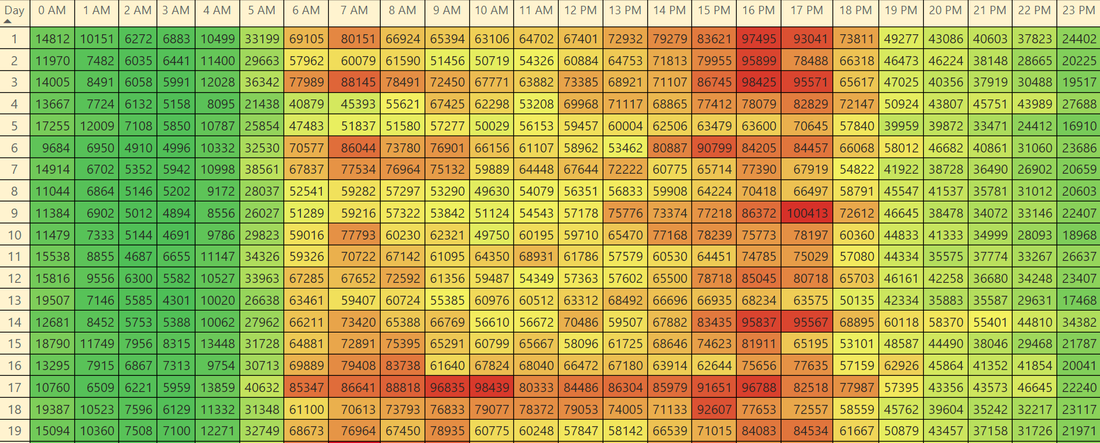
Hours and days Traffic Pattern year (2017)
High
Moderate
Patterns explains the Rush Hours during employees going to and from work.
Low

Slide 9
Recommendations for Future Decisions​
Conduct construction between 12 AM to 5 AM.
1
Schedule construction projects in February.
2
Stay away from clear or cloud weather days as possible.
3
Utilize time scale filter for traffic analysis for optimal construction scheduling
4

Slide 10
Thank you
Ahmed Elkady
Business Intelligence Analyst

